Slide 1


HUANG Junxin
9/3/2024

Slide 2

Outline
Executive Summary
Introduction
Methodology
Results
Conclusion
Appendix

Slide 3
Executive Summary
Summary of methodologies
Data Collection through API: Utilizing Application Programming Interfaces (APIs) to gather structured data.
Data Collection with Web Scraping: Employing techniques to extract data from websites.
Data Wrangling: Cleaning, structuring, and enriching raw data into a desired format for better decision making in less time.
Exploratory Data Analysis with SQL: Using Structured Query Language (SQL) to explore and analyze data, identifying patterns and insights.
Exploratory Data Analysis with Data Visualization: Creating visual representations of data to uncover hidden patterns and convey information clearly.
Interactive Visual Analytics with Folium: Using Folium library for visualizing geospatial data to create interactive maps for in-depth analysis.
Machine Learning Prediction: Applying machine learning algorithms to predict future events or outcomes based on historical data.

Slide 4
Executive Summary
Summary of all results
Exploratory Data Analysis result: Insightful patterns and trends identified through initial data analysis.
Interactive analytics in screenshots: Captured visual analytics that allow for interactive exploration of data, often saved as screenshots.
Predictive Analytics result: Outcomes of machine learning predictions, stating the accuracy, effectiveness, and potential applications.

Slide 5
Introduction
Project background and context
SpaceX has disrupted the space industry with its Falcon 9 rocket, which is offered at a cost of $62 million per launch on its website. This price point is significantly lower than that of other providers, who charge upwards of $165 million. A significant portion of SpaceX's cost savings derives from its ability to reuse the first stage of the Falcon 9. As such, predicting whether the first stage will land successfully is not only a technical challenge but also a financial one. If we can predict successful landings, we can estimate the cost of a launch more accurately. This prediction could serve as a crucial piece of information for alternate companies aiming to compete with SpaceX in the launch services market. The project's goal is to develop a machine learning pipeline that can predict the successful landing of the rocket's first stage.

Slide 6
Introduction
Problems you want to find answers
On what factors does the successful landing of a rocket depend?
What are the interactions between the various factors that determine the success of a landing?
What operational conditions are required to ensure a successful landing?

Slide 7

Section 1

Slide 8
Methodology
Executive Summary
Data collection methodology:
The data was collected using the SpaceX REST API, which provides a wealth of information about SpaceX launches. The specific endpoint used for this capstone assignment was api.spacexdata.com/v4/launches/past, which returns data on past SpaceX launches.
Perform data wrangling
Through Filtering Data and Resolving Missing IDs

Slide 9
Methodology
Executive Summary
Perform exploratory data analysis (EDA) using visualization and SQL
Perform interactive visual analytics using Folium and Plotly Dash
Perform predictive analysis using classification models
The data collected prior to this step were normalised into training and test datasets and evaluated by four different classification models, each of which was evaluated for accuracy by different combinations of parameters.

Slide 10
Data Collection
The data was collected using the SpaceX REST API, which provides a wealth of information about SpaceX launches. The specific endpoint used for this capstone assignment was api.spacexdata.com/v4/launches/past, which returns data on past SpaceX launches.

Slide 11
Data Collection – SpaceX API
Steps for Data Collection – SpaceX API:
API Request: A GET request was made to the SpaceX API endpoint using the requests library in Python.
JSON Response: The data returned from the API was in JSON format, a list of JSON objects where each object represented a past launch.
Data Extraction: The .json() method was called on the response object to extract the JSON data.
Data Normalization: To transform the structured JSON data into a flat table suitable for analysis, the json_normalize function was employed, which converts nested JSON into a pandas DataFrame.
API Request
JSON Response
Data Extraction
Data Normalization
Source code: https://github.com/huangjunxin/IBM-DS-Capstone/blob/main/Week%201/Hands-on%20Lab%20Complete%20the%20Data%20Collection%20API%20Lab/jupyter-labs-spacex-data-collection-api.ipynb

Slide 12
Data Collection - Scraping
Steps for Data Collection – Scriping:
SpaceX launch data is also available from Wikipedia;
Download the data from Wikipedia according to the flowchart and then persist it.
Place your flowchart of web scraping here
Request from Wiki
Extract from HTML
Store to Data Frame
Persist the data
Source code: https://github.com/huangjunxin/IBM-DS-Capstone/blob/main/Week%201/Hands-on%20Lab%20Complete%20the%20Data%20Collection%20with%20Web%20Scraping%20lab/jupyter-labs-webscraping.ipynb

Slide 13
Data Wrangling
Filtering Data: The dataset initially included launches for both Falcon 1 and Falcon 9 boosters. The data needed to be filtered to exclude Falcon 1 launches to focus solely on Falcon 9 data.
Resolving Missing IDs: Some columns contained identification numbers rather than direct data. By targeting specific endpoints on the API (e.g., Booster, Launchpad, Payload, Core), detailed information for each ID was retrieved and compiled into lists to enrich the dataset.
Source code: https://github.com/huangjunxin/IBM-DS-Capstone/blob/main/Week%201/Hands-on%20Lab%20Data%20Wrangling/labs-jupyter-spacex-Data%20wrangling.ipynb

Slide 14
EDA with Data Visualization
Catplot of Payload Mass vs. Flight Number colored by class (launch outcome) - This chart helps visualize the relationship between flight number, payload mass, and launch success. It shows that as flight number increases, success rate improves, and heavier payloads are associated with lower success rates.
Catplot of Flight Number vs. Launch Site colored by class - This scatter plot depicts the distribution of flight numbers across different launch sites, with the outcome indicated by color. It allows identifying which launch sites have higher flight numbers and success rates.
Scatter plot of Payload Mass vs. Launch Site colored by class - Similar to the previous plot, this one shows the distribution of payload mass launched from each site, along with the outcome. It reveals that certain sites handle heavier payloads and may have differing success rates.
Source code: https://github.com/huangjunxin/IBM-DS-Capstone/blob/main/Week%202/EDA%20with%20Visualization%20Lab/jupyter-labs-eda-dataviz.ipynb.jupyterlite.ipynb

Slide 15
EDA with Data Visualization
Bar chart of success rate for each orbit type - By grouping flights by orbit and calculating the mean success rate, this bar chart easily compares the success rates across different orbit types. It identifies which orbits have the best historical success.
Scatter plot of Flight Number vs. Orbit colored by class - This plot analyzes the potential relationship between flight number, orbit type and mission outcome. It can highlight if certain orbits have improving success rates as they are attempted more.
Scatter plot of Payload Mass vs. Orbit colored by class - Plotting payload mass against orbit type with outcome identified by color can reveal if heavier payloads tend to be associated with specific orbits and if there is any link between payload mass, orbit and success rate.
Line plot of yearly average success rate over time - By calculating the mean success rate for each year and plotting it as a line chart, the trend in success rates over the years can be visualized. An improving trend would indicate increasing reliability.
Source code: https://github.com/huangjunxin/IBM-DS-Capstone/blob/main/Week%202/EDA%20with%20Visualization%20Lab/jupyter-labs-eda-dataviz.ipynb.jupyterlite.ipynb

Slide 16
EDA with SQL
Displayed the names of the unique launch sites in the space mission
Displayed 5 records where launch sites begin with the string 'CCA'
Displayed the total payload mass carried by boosters launched by NASA (CRS)
Displayed average payload mass carried by booster version F9 v1.1
Listed the date when the first successful landing outcome on a ground pad was achieved
Listed the names of the boosters which had successful drone ship landings and payload mass between 4000 kg and 6000 kg
Listed the total number of successful and failed mission outcomes
Listed the names of the booster versions which carried the maximum payload mass, using a subquery
Listed the records showing the month names, failed drone ship landing outcomes, booster versions, and launch sites for the months in 2015
Ranked the count of landing outcomes between 2010-06-04 and 2017-03-20 in descending order
Source code: https://github.com/huangjunxin/IBM-DS-Capstone/blob/main/Week%202/Hands-on%20Lab%20Complete%20the%20EDA%20with%20SQL/jupyter-labs-eda-sql-coursera_sqllite.ipynb

Slide 17
Build an Interactive Map with Folium
Markers, circles, lines and clusters of markers are used with Folium maps
Markers indicate points such as launch sites
Circles indicate highlighted areas around specific coordinates, such as the NASA Johnson Space Centre
Marker clusters represent clusters of events at each coordinate, such as launches at a launch site
Lines indicate the distance between two coordinates
Source code: https://github.com/huangjunxin/IBM-DS-Capstone/blob/main/Week%203/Hands-on%20Lab%20Interactive%20Visual%20Analytics%20with%20Folium%20lab/lab_jupyter_launch_site_location.jupyterlite.ipynb

Slide 18
Build a Dashboard with Plotly Dash
Created an interactive dashboard with Plotly dash
Pie charts were created showing the total number of launches for a given site
Plotted scatter plots showing the relationship between different booster versions and outcomes and payload mass in kilograms.
Source code: https://github.com/huangjunxin/IBM-DS-Capstone/blob/main/Week%203/Hands-on%20Lab%20Build%20an%20Interactive%20Dashboard%20with%20Ploty%20Dash/spacex_dash_app.py

Slide 19
Predictive Analysis (Classification)
The data was loaded using numpy and pandas, transformed and split into training and testing parts.
Different machine learning models were built and tuned with different hyperparameters using GridSearchCV.
Accuracy was used as a measure of the model and feature engineering and algorithm tuning was used to improve the model.
Finally the best performing classification model was found.
Source code: https://github.com/huangjunxin/IBM-DS-Capstone/blob/main/Week%204/Hands-on%20Lab%20Complete%20the%20Machine%20Learning%20Prediction%20lab/SpaceX_Machine_Learning_Prediction_Part_5.jupyterlite.ipynb

Slide 20
Results
Exploratory data analysis results
SpaceX operates from four distinct launch sites.
The company's early launches served both its own and NASA's needs.
The average payload capacity of the Falcon 9 version 1.1 booster is 2,928 kg.
A milestone was reached in 2015 with the first successful booster landing, five years after the first launch.
Several versions of the Falcon 9 booster have successfully landed on drone ships, even with payloads above the average.
The mission success rate is close to 100%.
Two booster versions, specifically F9 v1.1 B1012 and F9 v1.1 B1015, failed to land on drone ships in 2015.
The rate of successful landings has shown improvement over the years.

Slide 21
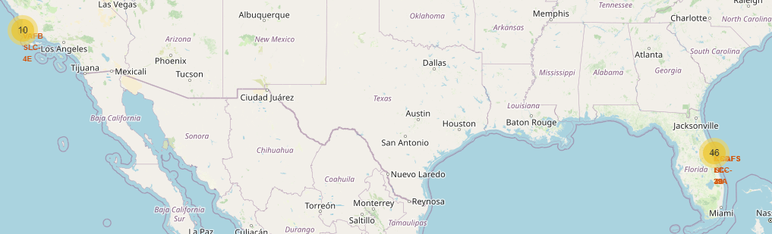
Results
Interactive analytics demo in screenshots
Interactive analytics revealed that launch sites are typically situated in safe locations, often near the sea.
These sites also benefit from robust logistic infrastructures in their vicinity.
A majority of launches are conducted from launch sites located on the east coast.

Slide 22
Results
Predictive analysis results
In terms of accuracy, the decision tree has the highest accuracy of 0.875 among all the classification models.
The main problem shown in the confusion matrix is false positives, where the classifier marks unsuccessful landings as successful landings.

Slide 23

Section 2

Slide 24
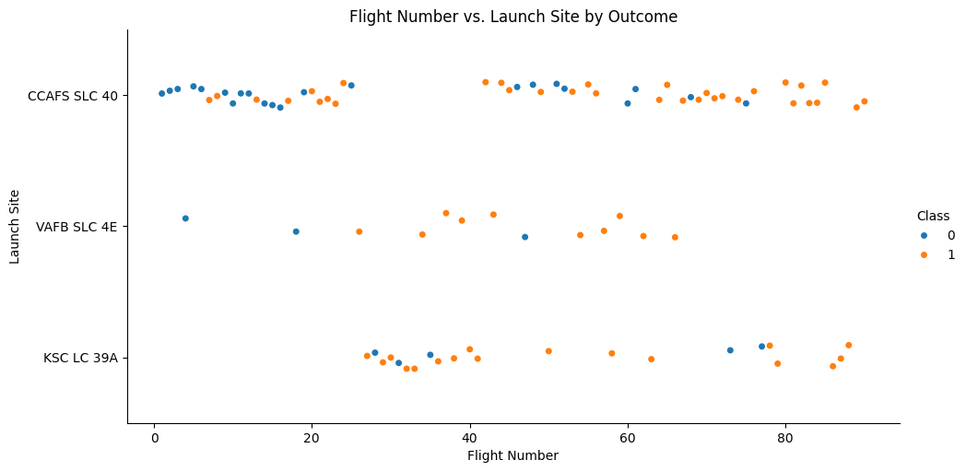
Flight Number vs. Launch Site
The more flights, the higher the success rate at the launch site.

Slide 25
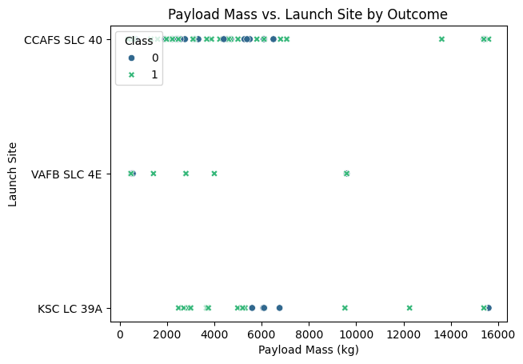
Payload vs. Launch Site
The larger the payload mass of the CCAFS SLC 40 at the launch site, the higher the success rate of the rocket.

Slide 26
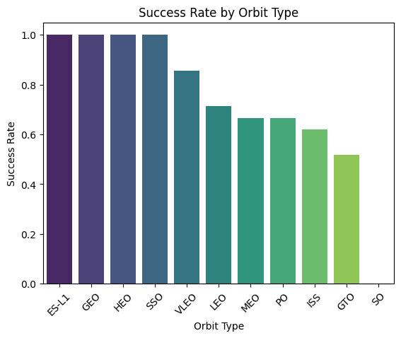
Success Rate vs. Orbit Type
The ES-L1, GEO, HEO, SSO had the highest success rate.

Slide 27
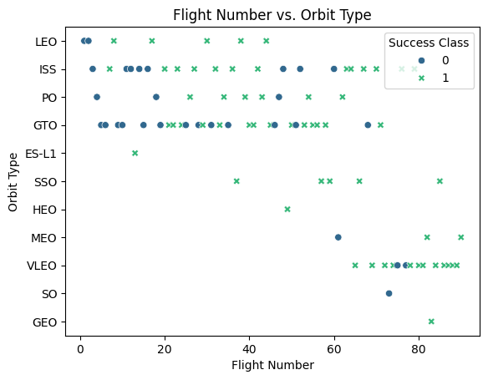
Flight Number vs. Orbit Type
The data points are distributed randomly, and there is no clear relationship between Flight Number and Orbit.

Slide 28
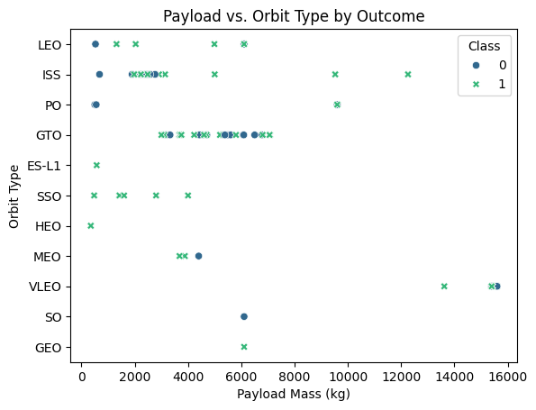
Payload vs. Orbit Type
LEO, ISS and PO orbits are more likely to have successful landings due to larger payloads.

Slide 29
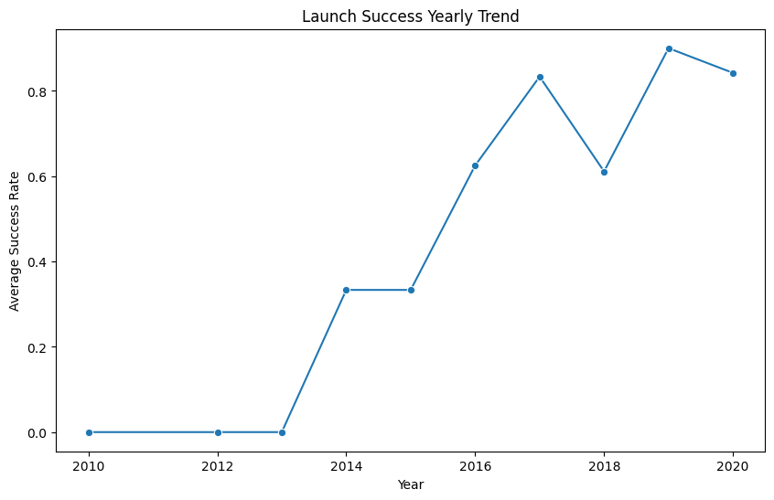
Launch Success Yearly Trend
Since 2013, the success rate has been increasing until 2020.

Slide 30
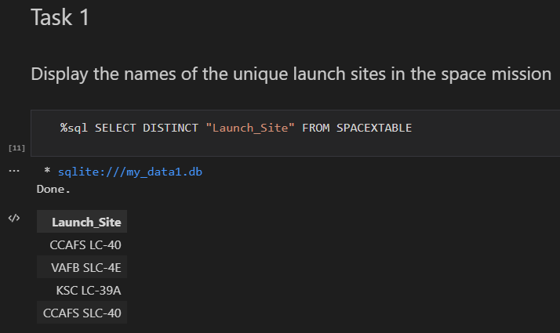
All Launch Site Names
Find the names of the unique launch sites using DISTINCT

Slide 31
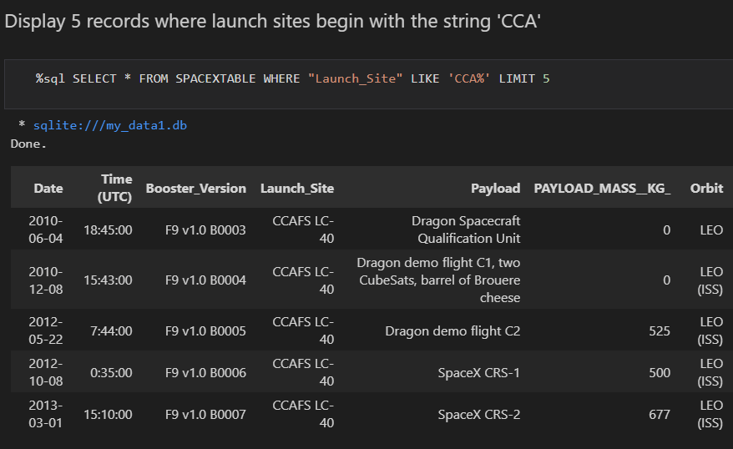
Launch Site Names Begin with 'CCA'
Find 5 records where launch sites begin with `CCA` using LIMIT

Slide 32
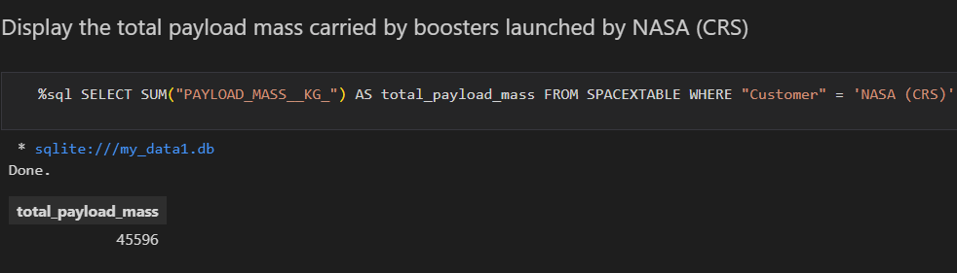
Total Payload Mass
Calculate the total payload carried by boosters from NASA using SUM()

Slide 33
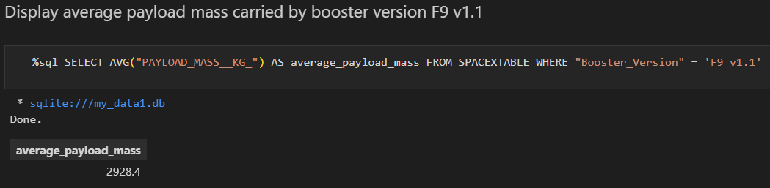
Average Payload Mass by F9 v1.1
Calculate the average payload mass carried by booster version F9 v1.1 using AVG()

Slide 34
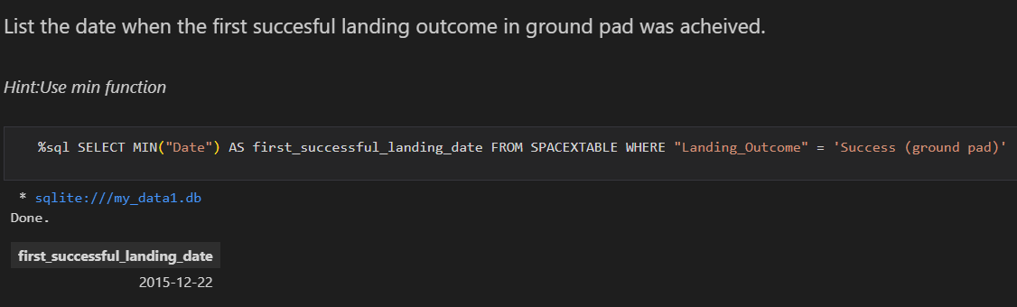
First Successful Ground Landing Date
Find the dates of the first successful landing outcome on ground pad using MIN()

Slide 35
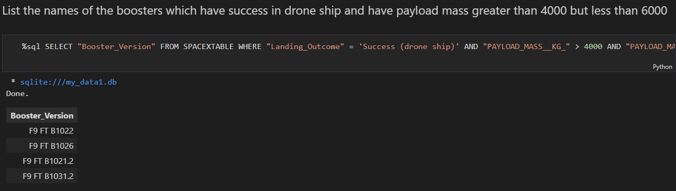
Successful Drone Ship Landing with Payload between 4000 and 6000
List the names of boosters which have successfully landed on drone ship and had payload mass greater than 4000 but less than 6000

Slide 36
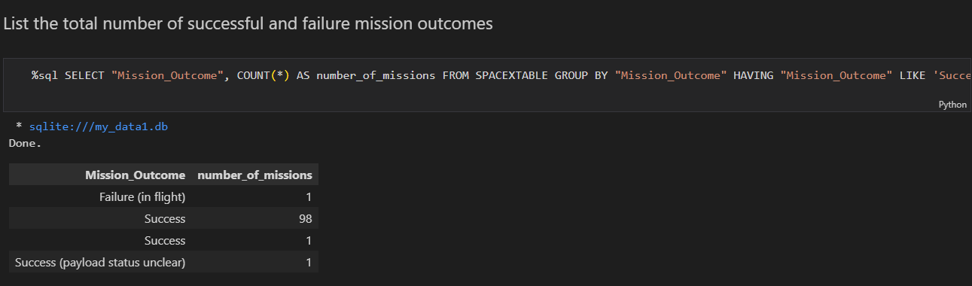
Total Number of Successful and Failure Mission Outcomes
Calculate the total number of successful and failure mission outcomes

Slide 37
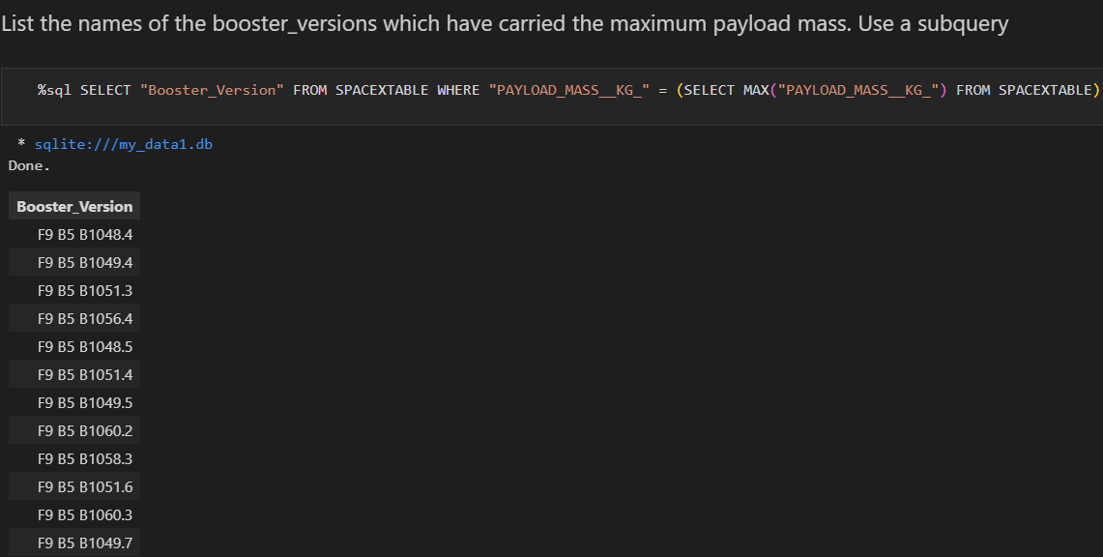
Boosters Carried Maximum Payload
List the names of the booster which have carried the maximum payload mass

Slide 38
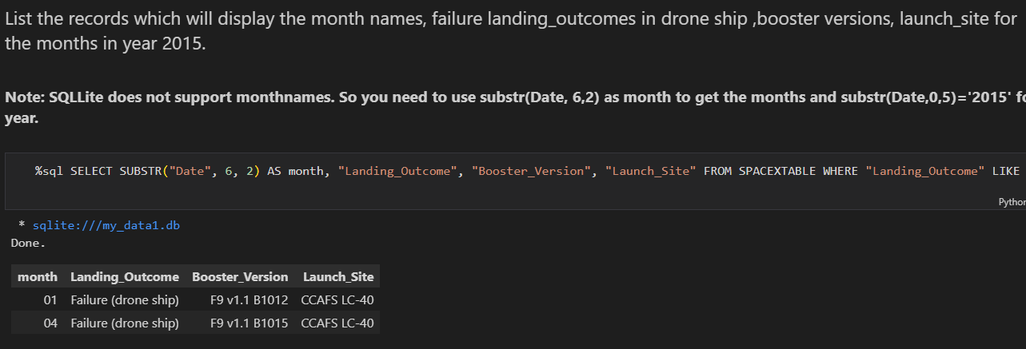
2015 Launch Records
List the failed landing_outcomes in drone ship, their booster versions, and launch site names for in year 2015

Slide 39
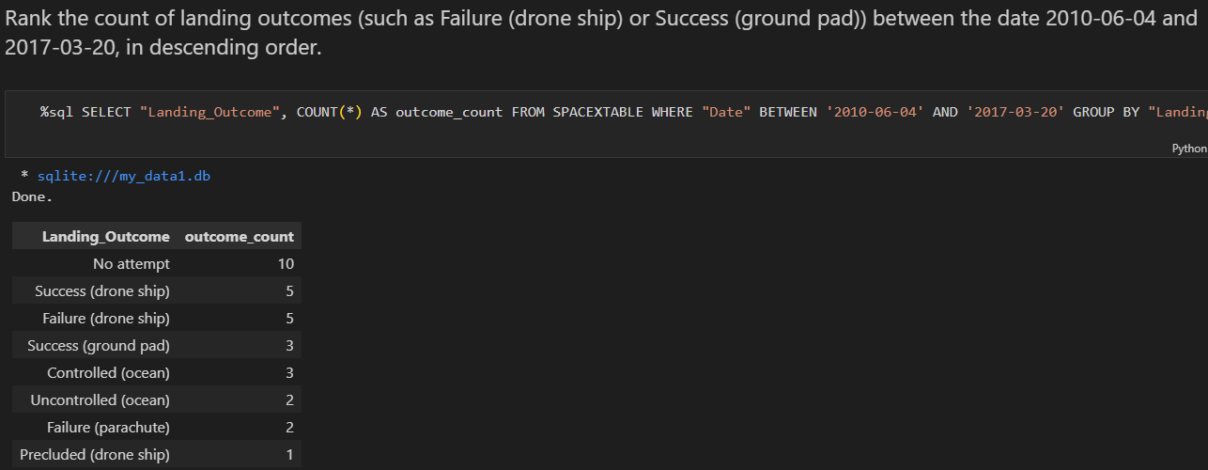
Rank Landing Outcomes Between 2010-06-04 and 2017-03-20
Rank the count of landing outcomes (such as Failure (drone ship) or Success (ground pad)) between the date 2010-06-04 and 2017-03-20, in descending order

Slide 40

Section 3

Slide 41
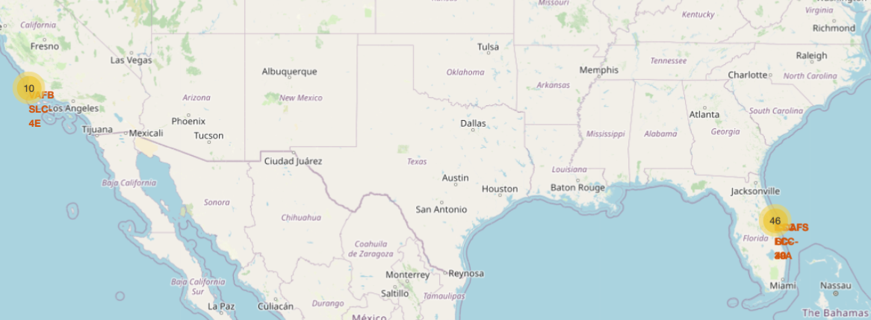
Launch Locations
The launch locations are in Florida and California.

Slide 42
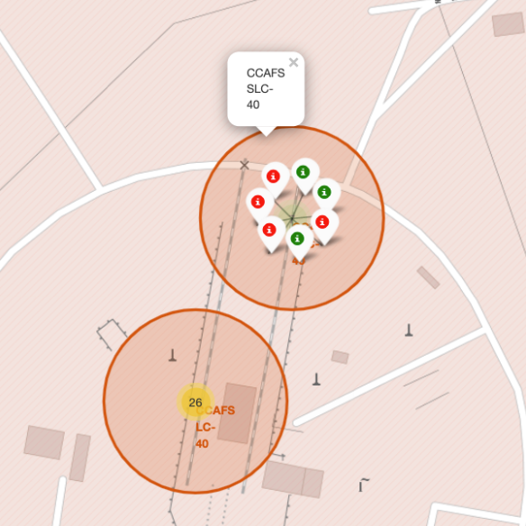
Use of colours to mark successful launches
The red markers indicates failure and the green markers indicates success.

Slide 43
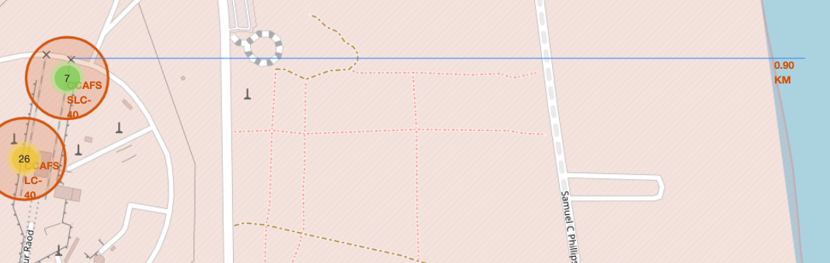
Launch sites are close to the coastline
It was found that the launch sites were all very close to the coastline.

Slide 44

Section 4

Slide 45
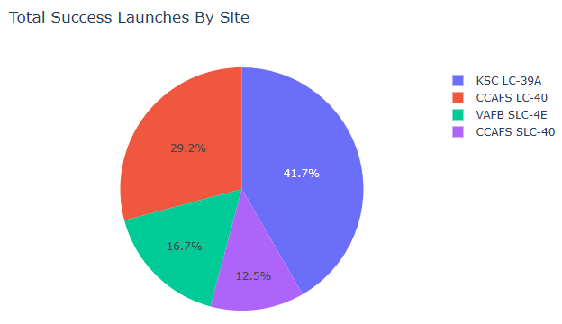
Total Success Launches by Sites
KSC LC-39A is the most successful launches from all sites

Slide 46
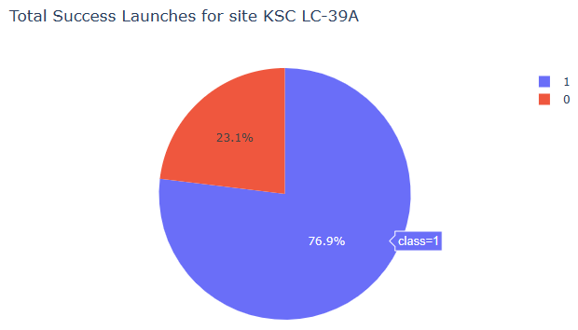
Launch Success Rate of KSC LC-39A
The launch success rate of KSC LC-39A was 76.9%.

Slide 47
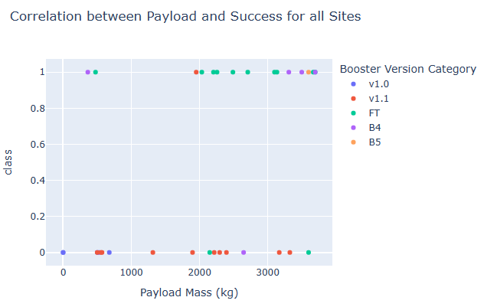
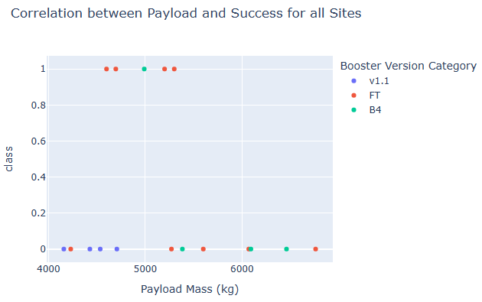
Effect of Different Payloads on the Success Rate
Low-weight payloads have a higher success rate than heavy payloads

Slide 48

Section 5

Slide 49
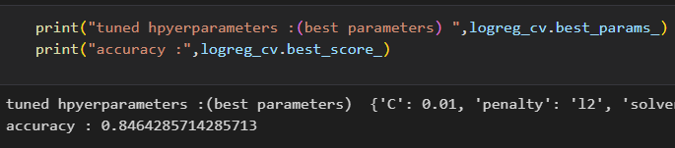
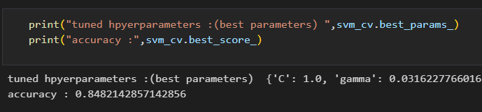
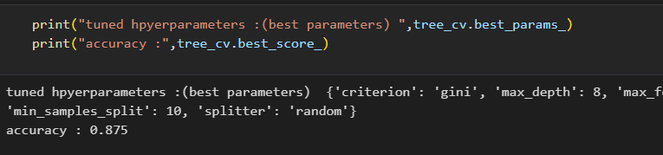
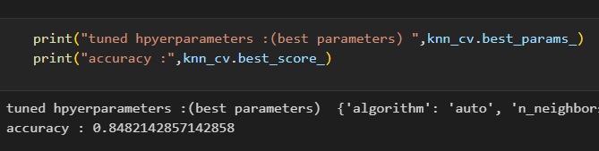
Classification Accuracy
We can see the results on the right-side.
In terms of accuracy, the decision tree has the highest accuracy of 0.875.

Slide 50

Confusion Matrix
The confusion matrix of the decision tree classifier shows that the classifier can distinguish between different categories.
The main problem is false positives, where the classifier marks unsuccessful landings as successful landings.

Slide 51
Conclusions
We can conclude that:
There is a correlation indicating that a higher volume of flights at a launch site tends to be associated with a higher success rate at that site.
The overall launch success rate began to climb in 2013 and continued to rise through 2020.
The orbits designated as ES-L1, GEO, HEO, SSO, and VLEO have experienced the highest success rates.
Kennedy Space Center's Launch Complex 39A (KSC LC-39A) has recorded the highest number of successful launches compared to other sites.
The Decision Tree classifier has been identified as the most effective machine learning algorithm for analyzing and predicting these outcomes.

Slide 52


